Slide 1
Numerical integration methods
Wojciech Metelski

Slide 2
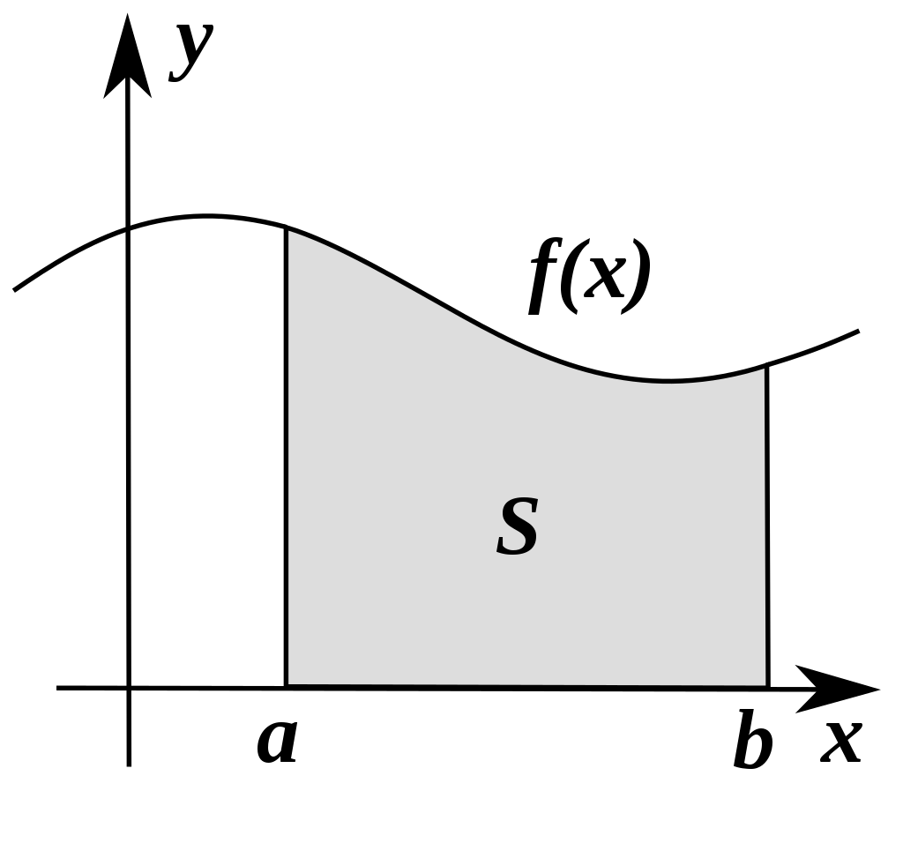
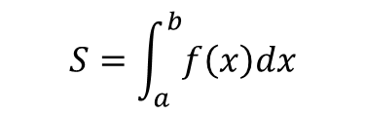
What integration is?
Integration is the process of evaluating an indefinite or definite integral:
$$S=\int_{a}^{b}{f\left(x\right)dx}$$

Slide 3
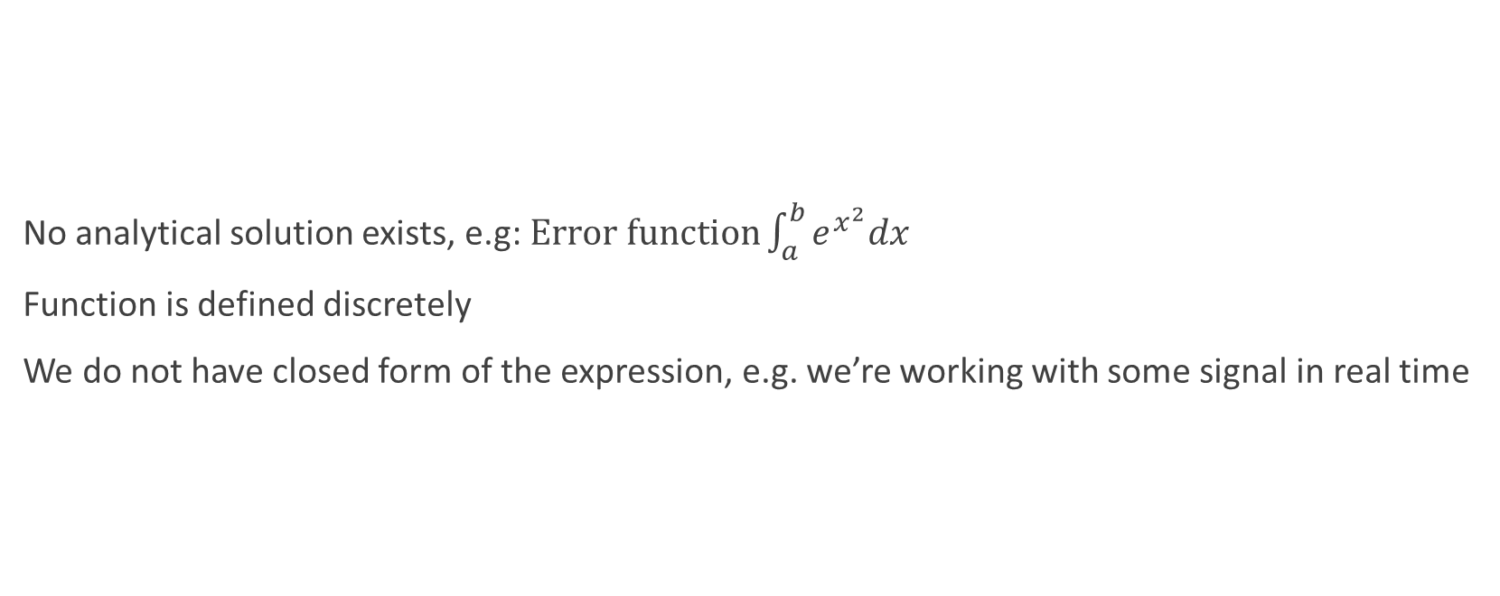
Why use numerical integration?
No analytical solution exists, e.g: $Error function\int_{a}^{b}{e^{x^{2}}dx}$
Function is defined discretely
We do not have closed form of the expression, e.g. we’re working with some signal in real time

Slide 4
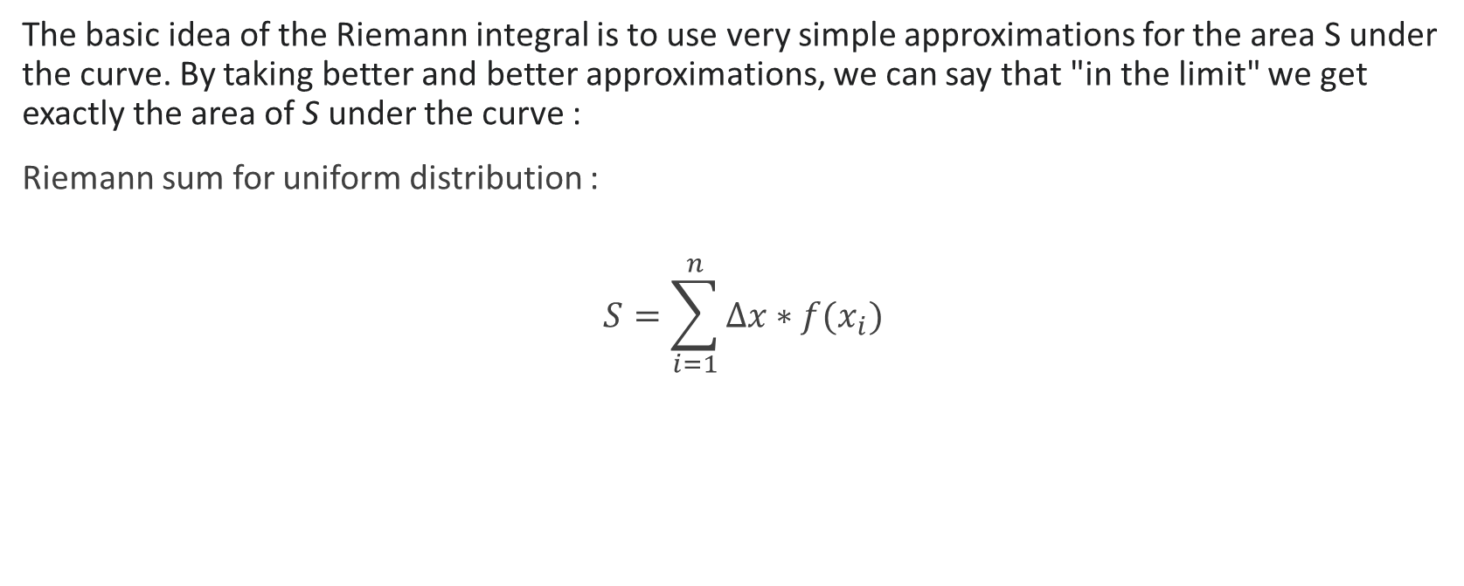
Riemann Sum
The basic idea of the Riemann integral is to use very simple approximations for the area S under the curve. By taking better and better approximations, we can say that "in the limit" we get exactly the area of S under the curve :
Riemann sum for uniform distribution :
$$S=\sum_{i=1}^{n}{∆x∗f(x_{i})}$$

Slide 5
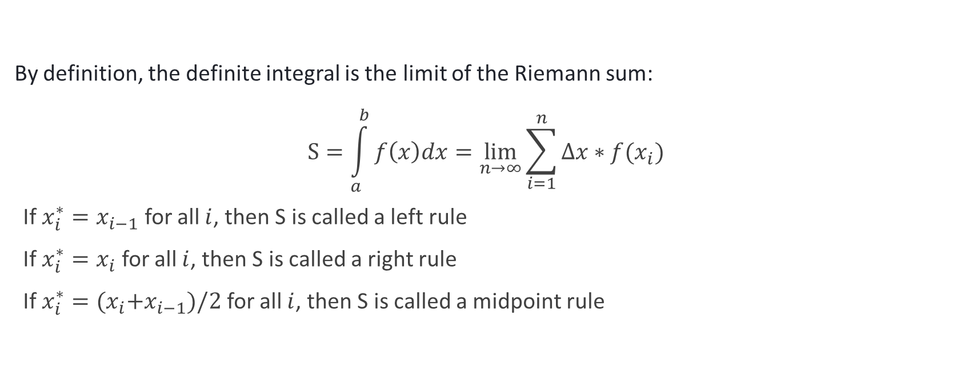
Riemann Sum continued
By definition, the definite integral is the limit of the Riemann sum: $$S=\int_{a}^{b}{f\left(x\right)dx=\lim_{n→∞}{\sum_{i=1}^{n}{∆x∗f(x_{i})}}}$$
If $x_{i}^{∗}=x_{i−1}$ for all $i$, then S is called a left rule
If $x_{i}^{∗}=x_{i}$ for all $i$, then S is called a right rule
If $x_{i}^{∗}={{(x}_{i}+x}_{i−1})/2$ for all $i$, then S is called a midpoint rule

Slide 6
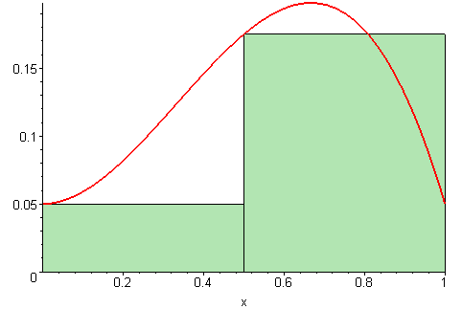
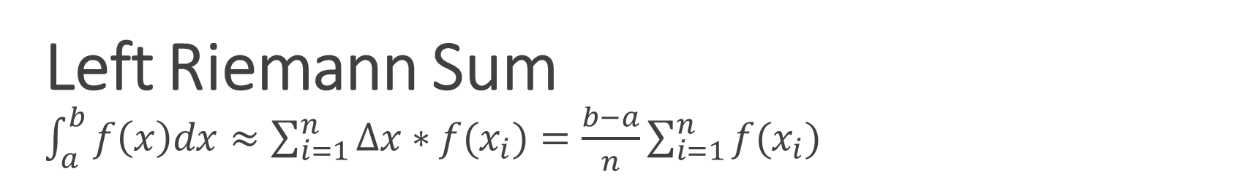
Left Riemann Sum $\int_{a}^{b}{f\left(x\right)dx≈\sum_{i=1}^{n}{∆x∗f(x_{i})}=\frac{b−a}{n}{\sum_{i=1}^{n}{f(x_{i})}}}$

Slide 7
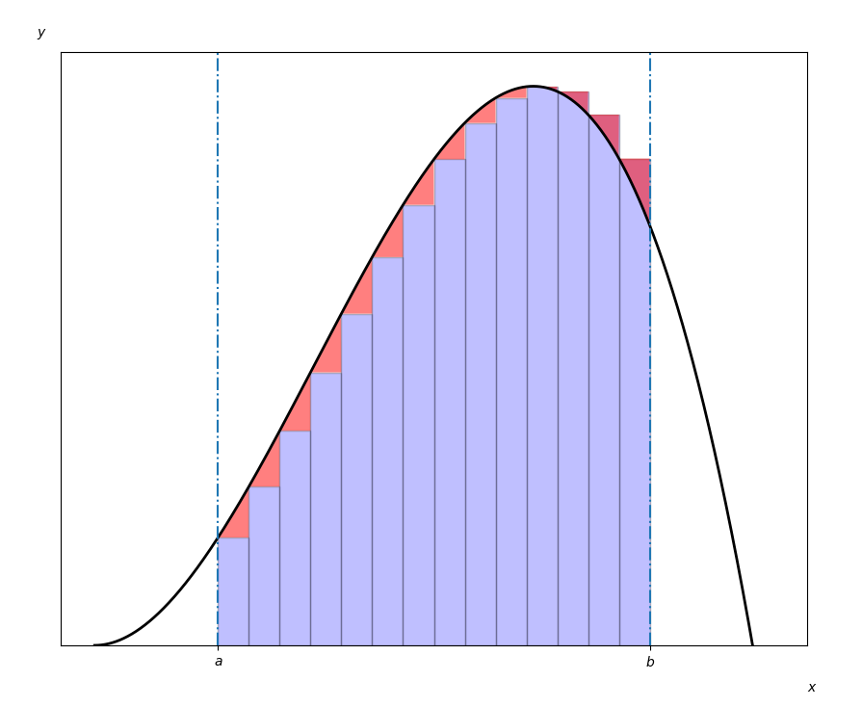
Estimation Error

Slide 8
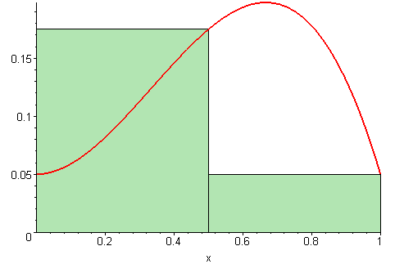
Right Riemann sum

Slide 9
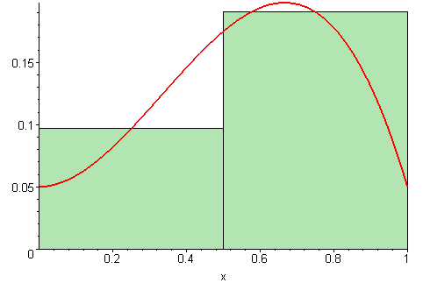
Midpoint Riemann sum

Slide 10
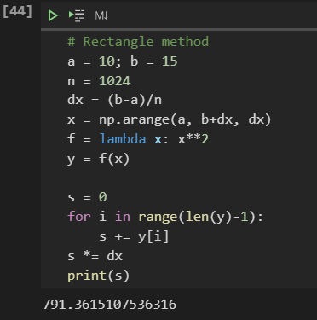
Code example

Slide 11
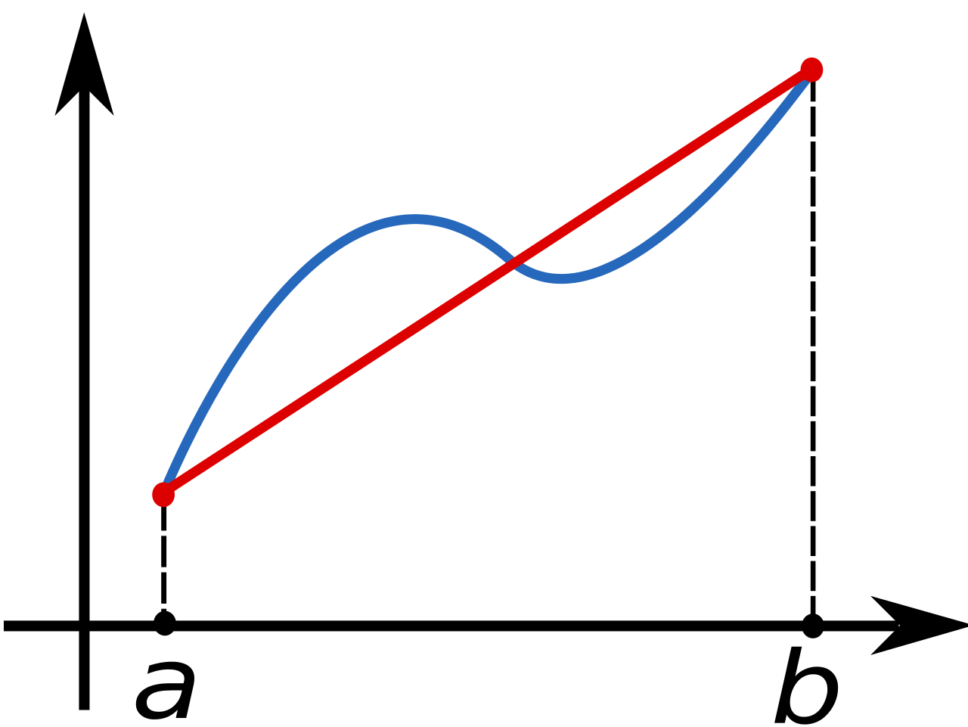
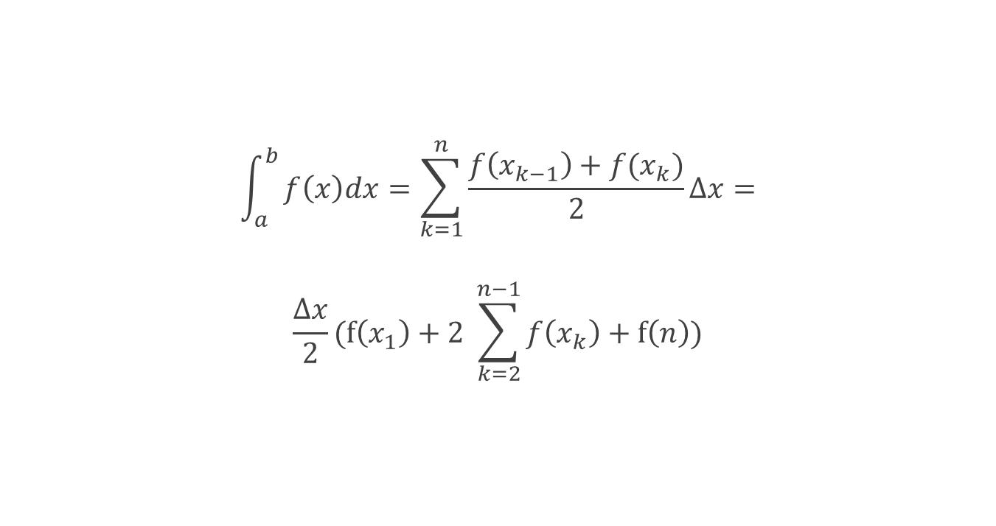
Trapezoidal rule Instead of fitting rectangles under the curve we can use trapezoids:
$$\int_{a}^{b}{f\left(x\right)dx=\sum_{k=1}^{n}{\frac{f\left(x_{k−1}\right)+f(x_{k})}{2}}}∆x=$$ $$\frac{∆x}{2}(f\left(x_{1}\right)+2 \sum_{k=2}^{n−1}{f\left(x_{k}\right)+f\left(n\right))}$$

Slide 12
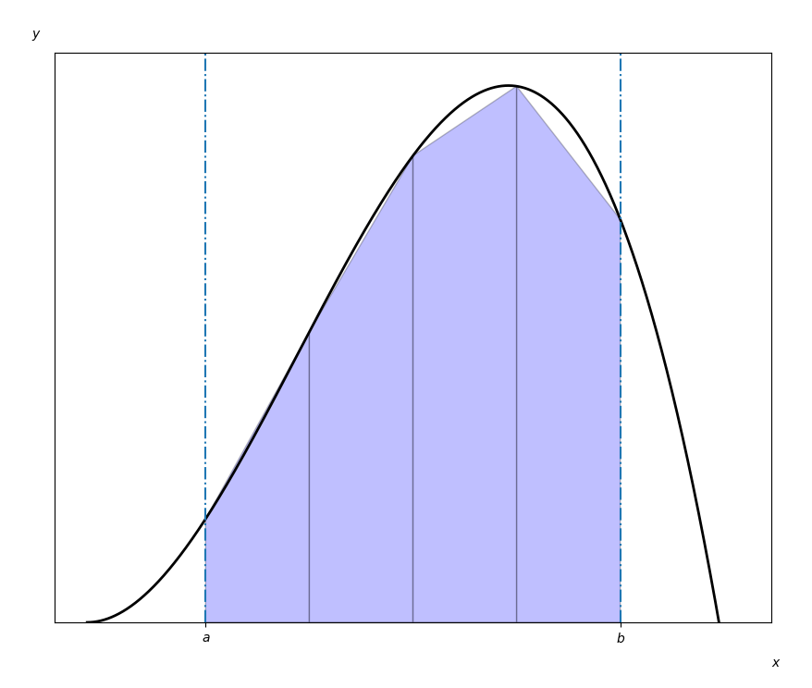
Trapezoidal rule continued

Slide 13
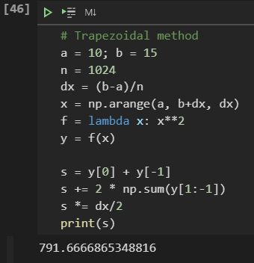
Code example

Slide 14
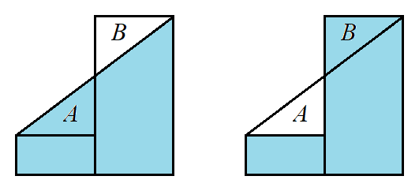
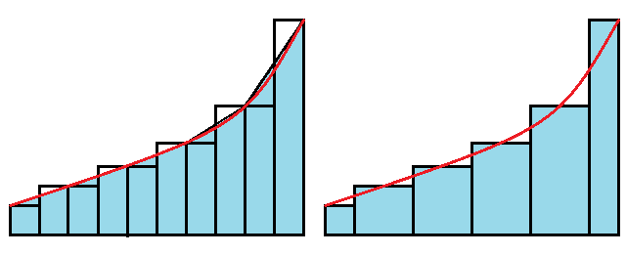
Trapezoidal rule vs Riemann sums

Slide 15

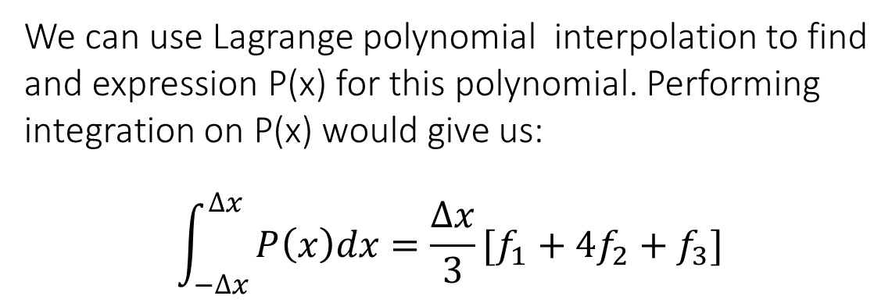
Simpson’s 1/3 rule
Suppose we have 3 adjacent points and we fit them to a second order polynomial:
$$f\left(x\right)=a_{0}+a_{1}x+a_{2}x^{2}$$
We can use Lagrange polynomial interpolation to find and expression P(x) for this polynomial. Performing integration on P(x) would give us:
$$\int_{−∆x}^{∆x}{P\left(x\right)dx=\frac{∆x}{3}[f_{1}+4f_{2}+f_{3}]}$$

Slide 16
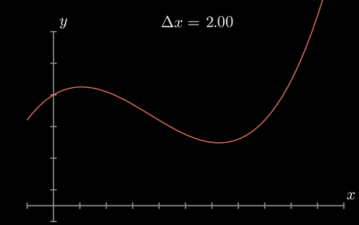
Simpson’s 1/3 rule continued

Slide 17
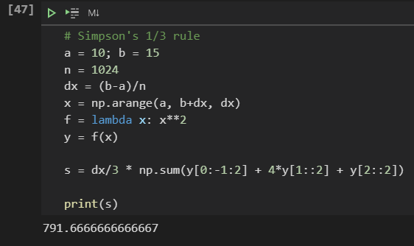
Code example

Slide 18
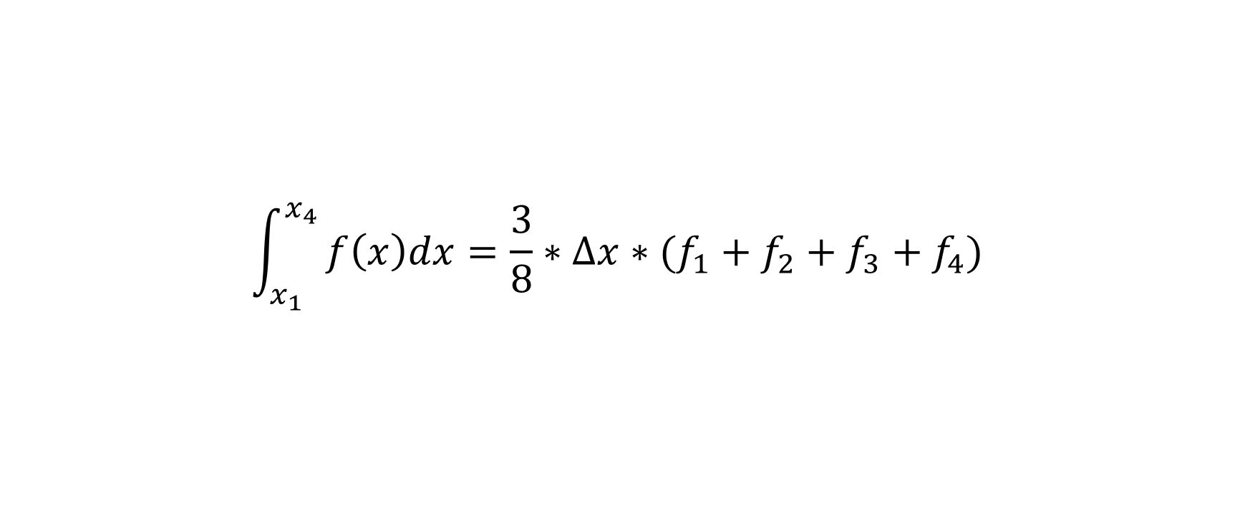
Simpson’s 3/8 rule Similar to Simspon’s 1/3 rule except we use higher order polynomial
$$\int_{x_{1}}^{x_{4}}{f\left(x\right)dx=\frac{3}{8}∗∆x∗(f_{1}+f_{2}+f_{3}+f_{4}})$$

Slide 19
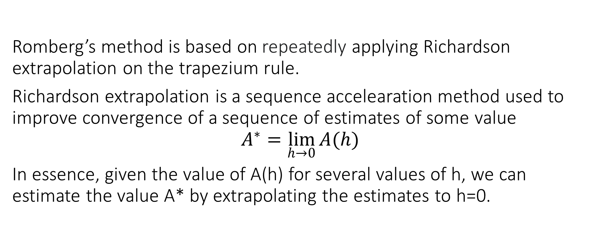
Romberg’s method
Romberg’s method is based on repeatedly applying Richardson extrapolation on the trapezium rule.
Richardson extrapolation is a sequence accelearation method used to improve convergence of a sequence of estimates of some value $$A^{∗}=\lim_{h→0}{A(h)}$$
In essence, given the value of A(h) for several values of h, we can estimate the value A* by extrapolating the estimates to h=0.

Slide 20
Romberg’s method continued
$$R\left(n,m\right)=\frac{1}{4^{m}−1}(4^{m}∗R\left(n,m−1\right)−R\left(n−1,m−1\right))$$
Approximation of the error function from 0 to 1
 | n = 1 | n = 2 | n = 3 | n = 4 | n = 5
m = 1 | 0.77174333
m = 2 | 0.82526296 | 0.84310283
m = 4 | 0.83836778 | 0.84273605 | 0.84271160
m = 8 | 0.84161922 | 0.84270304 | 0.84270083 | 0.84270066
m = 16 | 0.84243051 | 0.84270093 | 0.84270079 | 0.84270079 | 0.84270079

Slide 21
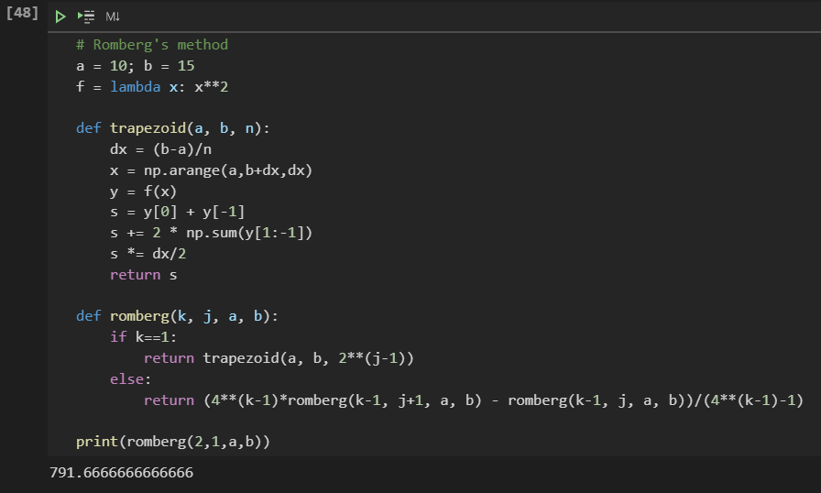
Code example

Slide 22
Thank you for your attention!

